Slide 1

The Reserve of Plaistow, NH
Annual Board Meeting
October 4, 2025
WELCOME!

Slide 2

AGENDA
Welcome - Greg
In Memoriam – Greg
Acknowledgements - Greg
Establish a Quorum - Cindy
Proof of Notice of Annual Meeting– Cindy
Formal Approval of 8/5/25 Minutes - Cindy
Annual Report from the Board
  Budget Review – Dianne
  Grounds/Pool Review – Jim
  Website - Deb
  Holiday Gathering -- Cindy
Nominees for Board Positions- Deb
Vote for Candidates and Budget - Greg
Break and Tally – Deb and 2 volunteers
Voting Results - Deb
Open Discussion

Slide 3


"Grief is like the ocean; it comes on waves ebbing and flowing. Sometimes the water is calm, and sometimes it is overwhelming. All we can do is learn to swim." —
Vicki Harrison
In Fond Memory of
Rosario “Sully” Scandura

Slide 4

ACKNOWLEDGEMENTS
  Jim O’Brien President Elect, Grounds and Pool
  Dianne Carlson Treasurer
  Cindy Connolly Secretary
  Debbie Bishop Director, Webmaster
  and thank you Reserve volunteers!
Thanks to All!

Slide 5

Our Annual Report
Budget review Dianne Carlson
Grounds/Pool Jim O’Brien
Website Debbie Bishop
Holiday Party Cindy Connolly

Slide 6

The Budget
Woohoo! NO HOA increase

Slide 7
End of Year Review
Carry over from 2025 to 2026 is $ 4,000.
Reserve Account Contribution $4,500 plus interest
HOA fee remains at $350.00
Major expenses: Landscape/Snow removal $88,500.
  Pool $ 6,716.
  Fertilization $ 6,313.

Slide 8

2025 Unplanned Expenses
Clubhouse
  Street light repair $761.
  Scrape, paint railings clubhouse $630.
  Replace side door clubhouse $600. .
  Replace TV clubhouse $448.
  Sprinkler panel repair clubhouse $325.
  Connect new cord for pool pump $185.
This Photo by Unknown Author is licensed under CC BY-SA

Slide 9

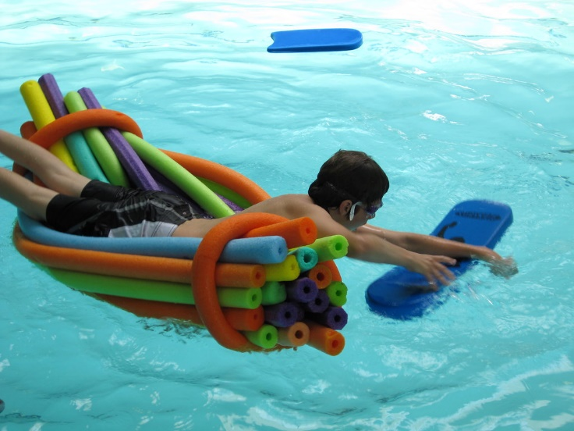
Grounds and Pool
Pool Contract
  Len Annaloro contract -- renewed
Landscaping and Snowplowing Contract
  Renewed D&J
Lawn Fertilization
  New one year contract with Integrity Turf

Slide 10


The Website
Thanks to those who shared information to post for the whole community!
Log in occasionally to familiarize yourself with information available
Vendor List has been updated
This Photo by Unknown Author is licensed under CC BY-SA

Slide 11

The Holiday Gathering
Annual Gathering will be held December 13, 2025 beginning at 6:00p.m. at the Clubhouse.
Sign up today to be on the planning committee!
Planning committee meeting to be held Oct. 29 at 6:00
This Photo by Unknown Author is licensed under CC BY-NC

Slide 12
Nominees for the Board
Cindy Connolly
Dianne Carlson

Slide 13

Cast two ballots
Budget approval Board members
This Photo by Unknown Author is licensed under CC BY

Slide 14

Thank you to our bakers and shoppers!
VERNA BAXTER
DIANNE CARLSON
SUSAN O’BRIEN
DEB BISHOP
CINDY CONNOLLY

Slide 15
AGENDA
Welcome - Greg
In Memoriam – Greg
Acknowledgements - Greg
Establish a Quorum - Cindy
Proof of Notice of Annual Meeting– Cindy
Formal Approval of 8/13/24 Minutes - Cindy
Annual Report from the Board
  Budget Review – Dianne
  Grounds/Pool Review – Jim
  Website - Deb
  Holiday Gathering -- Cindy
Nominees for Board Positions- Deb
Vote for Candidates and Budget - Greg
Break and Tally – Deb and 2 volunteers
Voting Results - Deb
Open Discussion

Slide 16

OPEN DISCUSSION

